Slide 1


Slide 2


Construya su Bot para Teams
Bruno Palma Ávila
Dev JS/C#

Slide 3
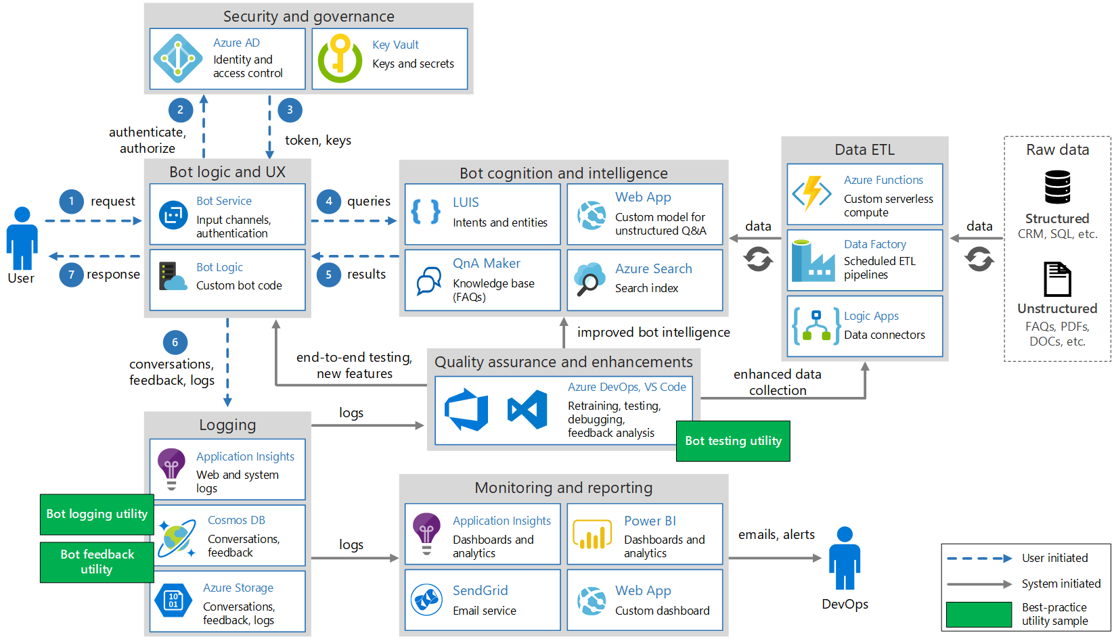
¿Qué es Bot Framework?

Slide 4

Características Bot Framework
Turnos (Http)
Controladores de actividad (OnMessageActivityAsync, OnMembersAddedAsync, etc)
Middleware
Control de estados
Dialogos
Cards
Auth
Canales

Slide 5
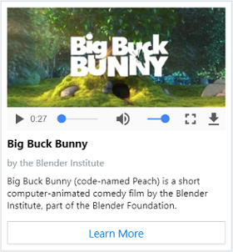
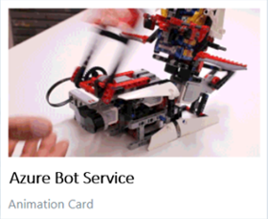
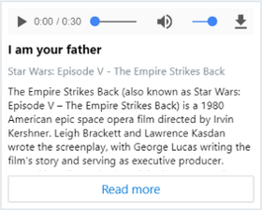
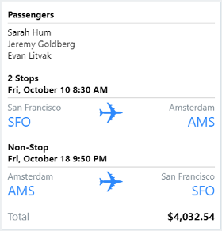
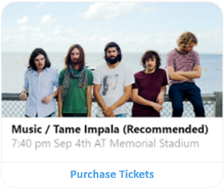
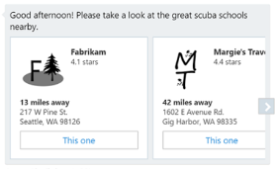
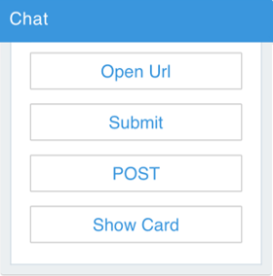
Cards
Animation Cards
Adaptive Cards
Audio Card
Video Card
Carousel Card
Hero Card
Suggested Actions Card

Slide 6


¿Qué servicios son necesarios? Y su letra chica
 | fREE | S1
Standard channels | Unlimited messages | Unlimited messages
Premium channels | 10,000 messages/month | $0.50 per 1,000 messages
Direct Line Speech Channel PREVIEW | N/A | Speech utterances..
 | FREE Try for free | SHARED Environment for dev/test | BASIC Dedicated environment for dev/test | STANDARD Run production workloads
Web, mobile, or API apps | 10 | 100 | Unlimited | Unlimited
Disk space | 1 GB | 1 GB | 10 GB | 50 GB
Price per hour | Free | $0.013 | $0.075 | $0.10

Slide 7
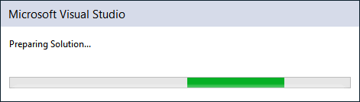

asd
Manos a la obra
https://github.com/LatinShare/PascueroBot
https://prod.liveshare.vsengsaas.visualstudio.com/join?4EE80C3EA9A77853A5E9A9FD5C45888E6FFC

Slide 8
Capacidades del Bot en Teams
Todas las capacidades de Teams (Tabs, conectores, Extensiones de Mensajes, Notificaciones, Microfono, Dominios válidos)
Comandos
Menciones
Chat (Grupal, individual, Teams)
Search bar
Store
Eventos Teams (https://docs.microsoft.com/en-us/microsoftteams/platform/bots/bot-basics?tabs=csharp#teams-specific-handlers)
Eliminar/Actualizar mensajes
No soportado:
Animation cards
Audio cards
Video cards

Slide 9

¿Ahora cómo lo implemento en Teams?
+
Notes:
Links importantes
Desarrollo en Teams: https://docs.microsoft.com/en-us/microsoftteams/platform/overview
Publicar app en Teams: https://docs.microsoft.com/en-us/microsoftteams/platform/concepts/deploy-and-publish/apps-upload
Bot en Teams: https://docs.microsoft.com/en-us/microsoftteams/platform/bots/what-are-bots
Formato Textos: https://docs.microsoft.com/en-us/microsoftteams/platform/task-modules-and-cards/cards/cards-format
Cards: https://docs.microsoft.com/en-us/microsoftteams/platform/task-modules-and-cards/cards/cards-reference

Slide 10



Debug
https://ngrok.com/download
ngrok http 3978 -host-header="localhost:3978"

Slide 11
Problemas típicos
Ngrok expirado o multiples conexiones
Appsetings erroneas
Habilitar el canal de Teams

Slide 12
¿?

Slide 13
Link Importantes
Bot Samples
Bot Framework Emulator
Pascuero Bot
Nuevas Características en Bot Framework

